Slide 1

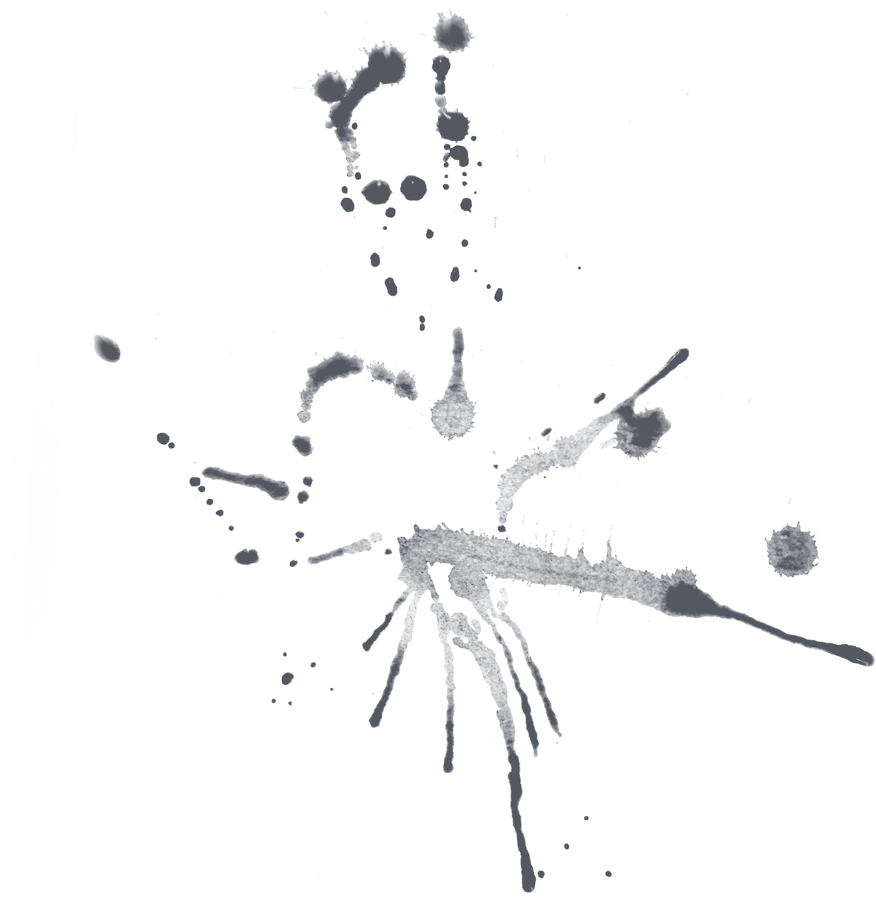





AGENT BASED RAG CHATBOT
By Vithya Sri R

Slide 2
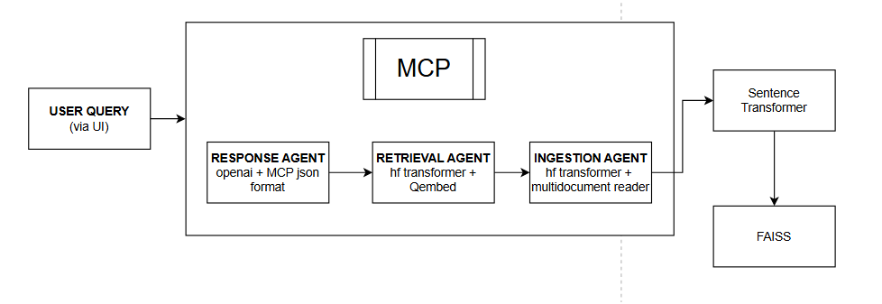
ARCHITECTURE DIAGRAM

Slide 3
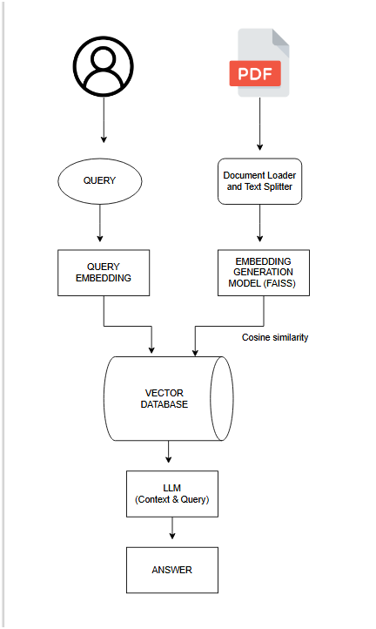
FLOW DIAGRAM

Slide 4
TECH STACK USED
COMPONENT | TECHNOLOGY
Document Embedding | sentence-transformers
Vector Store | FAISS
Language Model | google/flan-t5-base
Frontend / UI | Streamlit
Document Parsing | PyMuPDF, pdfplumber, Markdown
Programming Language | Python 3.x

Slide 5
CHALLENGES FACED
Embedding large documents was solved by chucking into smaller segments (1000 characters)
Managing vector store for multi-format documents and enhancing cosine similarity
Real-time chat management(history,chat session) in streamlit UI

Slide 6
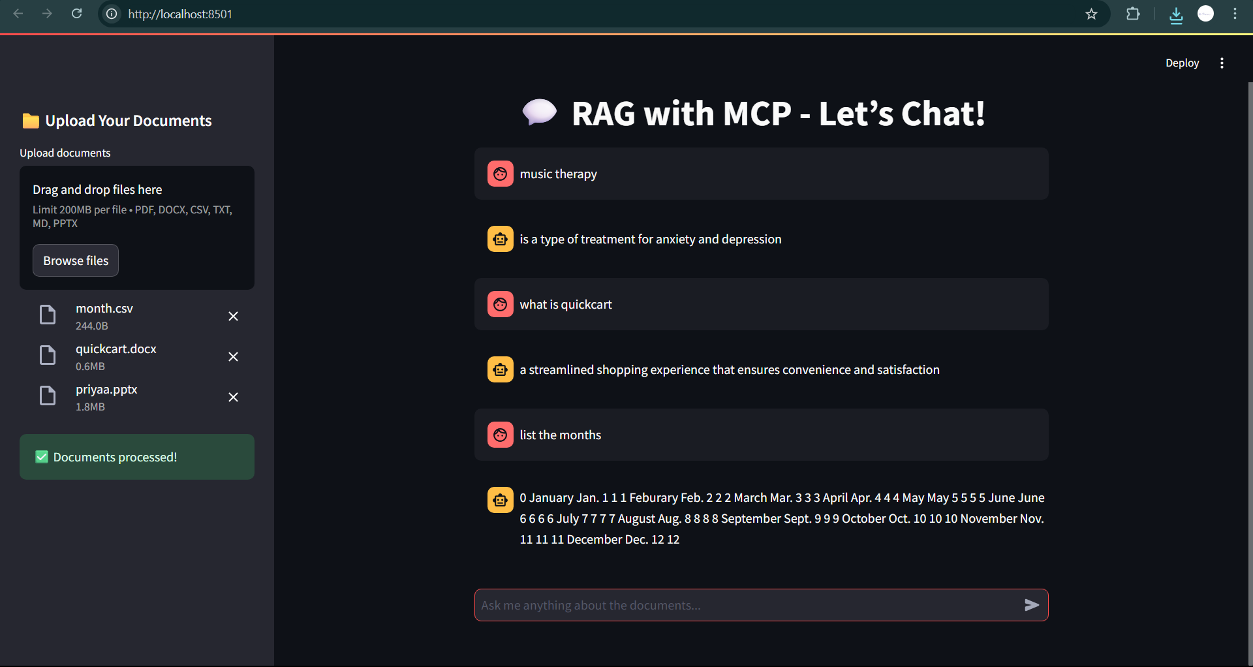
RESULT

Slide 7
THANK YOU

